Slide 1
Task 5.2

Slide 2
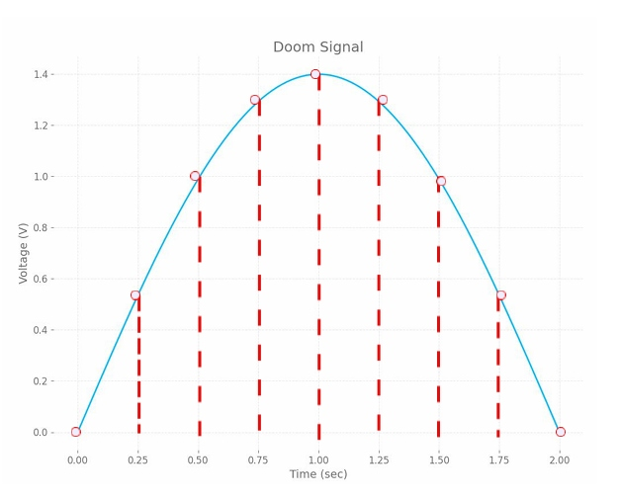
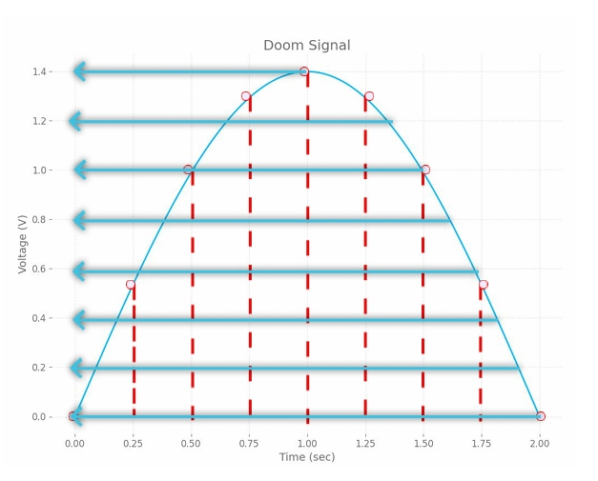
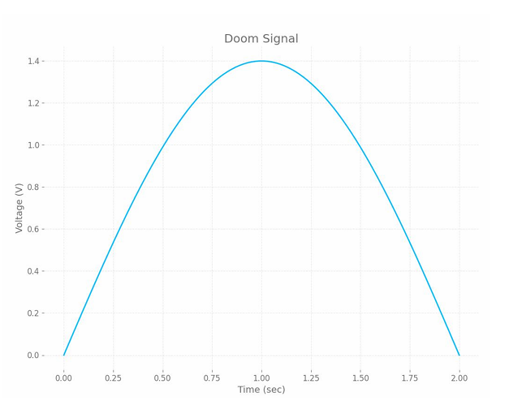
3-bit encoder with Sampling Time = 0.25
111
110
101
100
011
010
001
000
Bit Sequence = 000010101110111110101010000

Slide 3
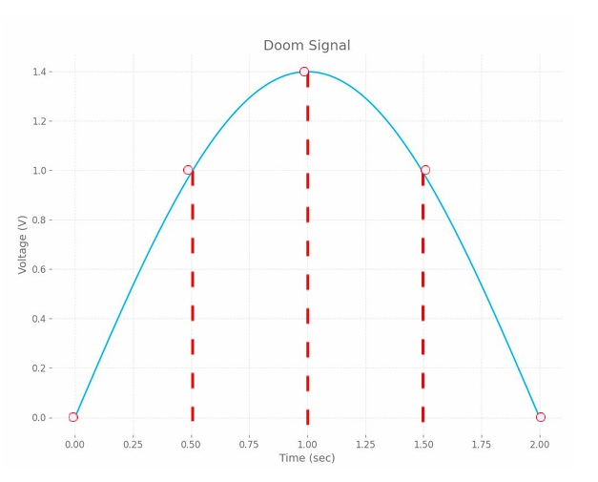
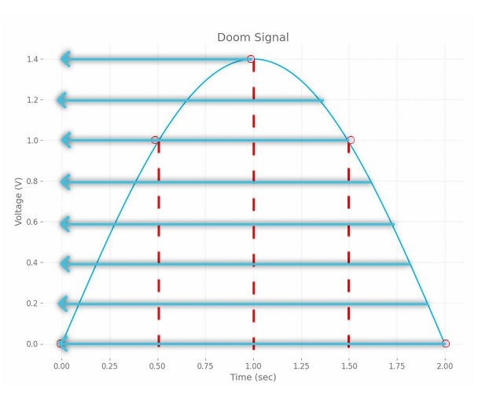
3-bit encoder with Sampling Time = 0.5
111
101
000
Bit Sequence = 000101111101000

Slide 4
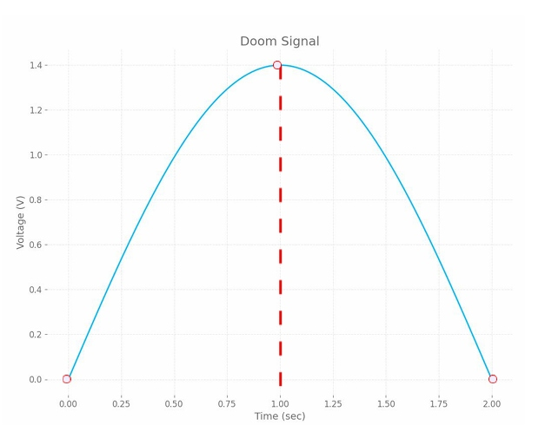

3-bit encoder with Sampling Time = 1
111
000
Bit Sequence = 000111000

Slide 5
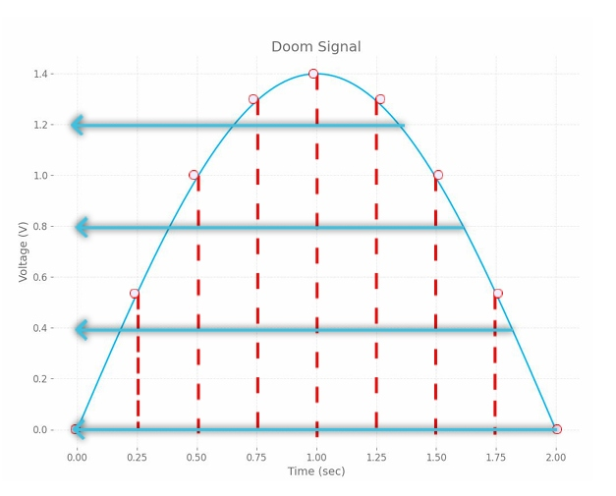
2-bit encoder with Sampling Time = 0.25
11
10
01
00
Bit Sequence = 000110111111100100

Slide 6
Thank you

